Slide 1
Chapter 4 Thread & Concurrency

Slide 2
Outline
Overview
Multicore Programming
Multithreading Models
Thread Library
Implicit Threading
Threading Issues
Operating-System Examples

Slide 3
Motivations
Problem: global warming (全球暖化)
Solutions
1. Reduces personal desires
2. Resource sharing
Problem: process is high overhead
Why?
Solutions
1. Reduces personal desires: minimize code size or shorten execution time
2. Resource sharing: by threads

Slide 4
Example: Matrix Multiplication- Single Process Solution
memory
Assume four CPU cores are available
Core 1
code
data
Core 2
stack
…..
Core 3
1. Three CPU cores are idle
2. This process has long execution time
Core 4

Slide 5
Your Solutions?

Slide 6
Example: Matrix Multiplication- Multiple Processes Solution
code
Assume four CPU cores are available
Core 1
data
fork()
stack
fork()
fork()
Core 2
…
code
Core 3
data
1. All of the four CPUs are used.
2. But, the code and data sections of these four processes are all the same (memory wastage)
stack
Core 4
…
…
…

Slide 7
Your Solutions?

Slide 8
Example: Matrix Multiplication- One Process with Multiple Threads Solution
one process
memory
Assume four CPU cores are available
code
Core 1
c_thread()
data
c_thread()
stack
c_thread ()
Core 2
stack
stack
All CPU Cores are busy
Memory usage is economic
The process’s execution time is short
Core 3
stack
Core 4

Slide 9
問題:同一個Process的Threads哪些可以共享?哪些不行?

Slide 10
Thread Overview
Process: High overhead abstraction to execute a program
E.g., creating process is as an expensive operation.
Each process have its own code, data, heap, and stack segments
Solutions: thread
A basic unit of CPU utilization
Like process, also need resources like thread ID, program counter, register set, and stack…
Some resources are shared with other threads belonging to the same process
Code section, data section, and other OS resources, such as open files and signals

Slide 11
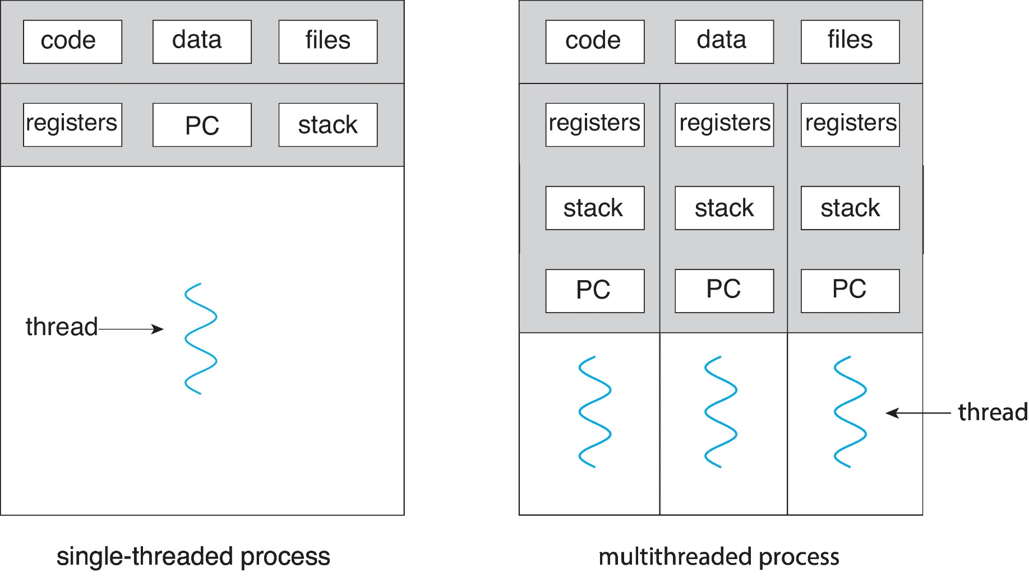
Single and Multithreaded Processes

Slide 12
If Three CPU Cores are Available
main() {
pthread_create(runner());
x = x +1;
y = y + 1;
}
runner() {
pthread_create(readrun());
i = i + 6;
j = j * 8;
}
readrun()
{
c = c + 2;
d = 10 ;
}
a process
Thread 1
Thread 1
If three CPU cores are available, these three threads can run in parallel
Thread 2
Thread 2
Thread 3
Thread 3
Multithreaded Process: an application can have
several different threads of activity within the same address space

Slide 13
Create a Process v.s Create a Thread
memory
memory
code
code
data
fork()
data
thread_create()
stack
stack
…
…
code
stack
New thread
New process
data
…
stack
…

Slide 14
Thread Control Block (or Thread Descriptor)
Thread ID
Thread State (Run, Waiting…)
Program Counter
Registers
……
Each thread has its own TCB, like each process has its PCB

Slide 15
Threads也有自己的執行狀態。 所以，Context Switch時必須 (1)將目前正在執行Thread的狀態儲存到TCB (2)復原接下來要執行Thread的狀態 (see the following slide)

Slide 16
Context Switches in Threads - Just like Context Switch in Processes
CPU
eax = 8 ;
ebx = 11;
Thread 1
main()
{
.
a = a +1;
pthread_create(..runner());
}
runner()
{
.
.
b = b + 5;
c = b * 10;
}
eax = 3;
ebx = 19;
eax = 8;
ebx = 11;
Thread 1
Thread 1
Context switch
Thread 2
eax = 8 ; ebx = 11;
TCB₁
Thread 2
TCB
(in memory)
Thread 2
TCB₂
Context switch
Change to Thread 1
eax = 3 ; ebx = 19;

Slide 17
Why Can’t Share the Same Stack
main()
{
.
.
a = a + 1;
function_1(…);
exit(1);
}
function_1()
{
b = b - 1;
function_2(…);
return;
}
function_2()
{
…
return;
}
stack
ESP
arugment
return address
local variables
ESP
argument
return address
local variables
ESP
argument
return address
local variables

Slide 18
From above figure, do you know why threads of the same process cannot share the same stack?

Slide 19
Benefits
Responsiveness
If one thread is blocked or performing a lengthy operation, other threads can continue running
Resource Sharing
Threads share the memory (code and data) and resources of the process to which they belong
Economy
Create and context-switch thread is much quickly than processes
Compared with processes, 30 times faster in creating and 5 times faster when context switch
Scalability
Multithreading on a multi-CPU machine increases concurrency
Each thread may be running in parallel

Slide 20
Examples
A lot of software packages are multi-threaded
File servers or web servers
Needs to handle several requests over a short period
How to do ?
1. Process sequentially: bad
2. Create a single process for each request
Process creation is time consuming and resource intensive
3. Create a single thread for each request
More efficient
Web browser:
One thread: display images or text, one thread: retrieve data
Matrix multiplication

Slide 21
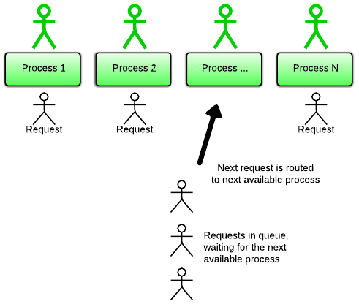
Multi-Process I/O Solution
1. Receive requests
2. create a process to service the request
Dispatcher process
Multi-process I/O model. Each process handles 1 client at a time.
https://www.rubyraptor.org/how-we-made-raptor-up-to-4x-faster-than-unicorn-and-up-to-2x-faster-than-puma-torquebox/

Slide 22
Multi-Thread I/O Solution
thread
thread
thread
thread
1. Receive requests
2. create a thread to service the request
Dispatcher thread
Multi-thread I/O model. Each thread handles 1 client at a time.
https://www.rubyraptor.org/how-we-made-raptor-up-to-4x-faster-than-unicorn-and-up-to-2x-faster-than-puma-torquebox/

Slide 23
複習：Example: Matrix Multiplication- One Process with Multiple Threads Solution
one process
memory
Assume four CPU cores are available
code
Core 1
c_thread()
data
c_thread()
stack
c_thread ()
Core 2
stack
stack
All CPU Cores are busy
Memory usage is economic
The process’s execution time is short
Core 3
stack
Core 4

Slide 24
Outline
Overview
Multicore Programming
Concurrency v.s. Parallelism
Types of Parallelism
Multi-Core Programming Challenges
Multithreading Models
Thread Library
Implicit Threading
Threading Issues
Operating-System Examples

Slide 25
Concurrency v.s. Parallelism
On a single-processor system, processes were running concurrently, but not in parallel
Concurrency supports more than one task making progress
However, with multicore systems, processes can run in parallel
Parallelism implies a system can perform more than one task simultaneously

Slide 26
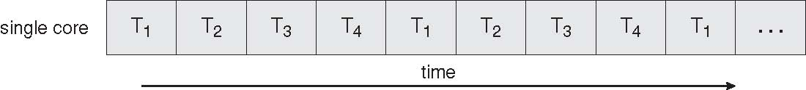
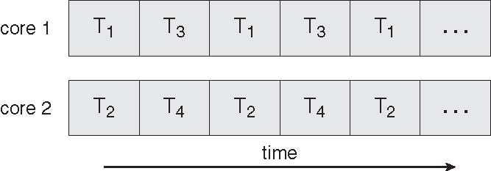
Concurrency vs. Parallelism Four Threads: T1, T2, T3, T4
Concurrent Execution on a Single-core System
Parallel Execution on a Multi-core System

Slide 27
Outline
Overview
Multicore Programming
Concurrency v.s. Parallelism
Types of Parallelism
Multi-Core Programming Challenges
Multithreading Models
Thread Library
Implicit Threading
Threading Issues
Operating-System Examples

Slide 28
Types of Parallelism
Two types of parallelism: data parallelism v.s. task parallelism
Data parallelism
Running the same task on different components of data
Ex: summing an array of size 1000 (if two cores)
Thread A on one core sums the element [0]…[499]
Thread B on another core sum the element [500]…..[999]
Task parallelism
Running many tasks on the same data
Ex:
Hybrid
Most applications use a hybrid of the two strategies
program:
//task parallelism
...
if CPU = "a" then
do task "A"
else if CPU="b" then do task "B"
end if
...
end program

Slide 29
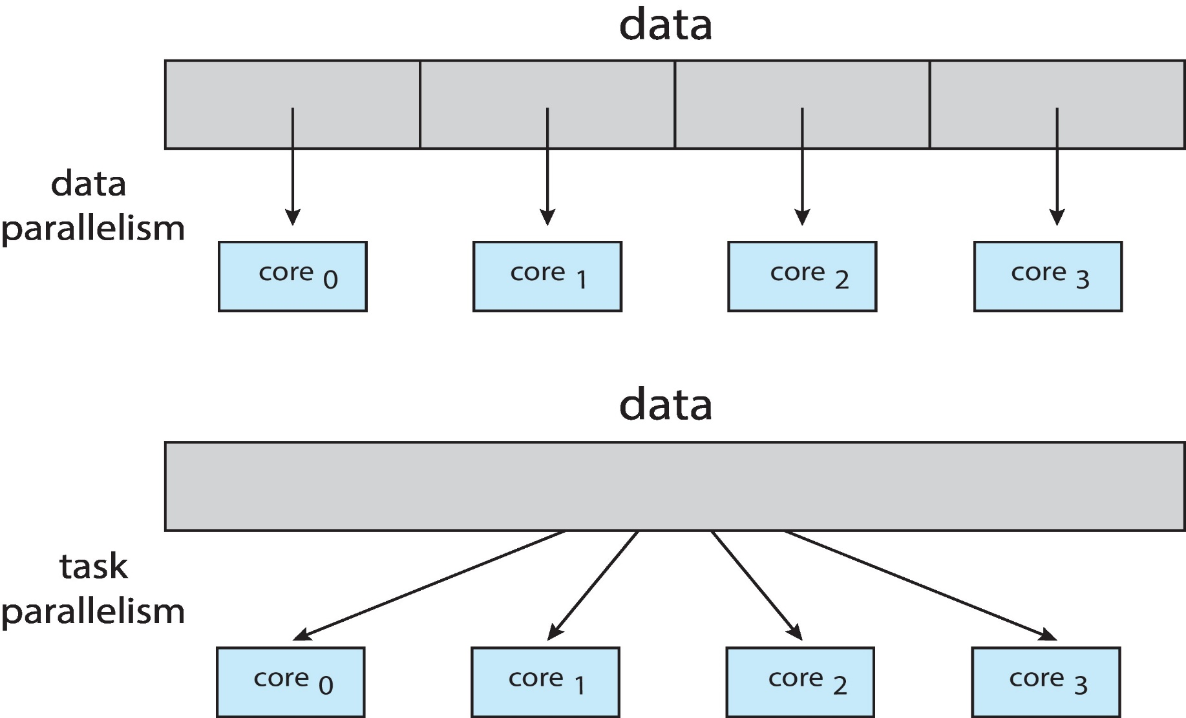
Data Parallelism and Task Parallelism

Slide 30
Outline
Overview
Multicore Programming
Concurrency v.s. Parallelism
Types of Parallelism
Multi-Core Programming Challenges
Multithreading Models
Thread Library
Implicit Threading
Threading Issues
Operating-System Examples

Slide 31
Multi-Core Programming Challenges
Multicore programming is challenge
Divide activities
Divide an application into separate threads
Balance
Each thread perform equal work of equal value
Data splitting
Data accessed by each thread must be divided to run on each core
Data dependency
Discussed in Chapter 6
Testing and debugging
More difficult than single-threaded applications

Slide 32
Outline
Overview
Multicore Programming
Multithreading Models
Thread Library
Implicit Threading
Threading Issues
Operating-System Examples

Slide 33
Question: How to Support Thread?

Slide 34
Supporting Threads
思考 1:
fork() is used to create process.
所以，程式設計師需要一個function來create thread, 假設此一function 為 pthread_create()
思考 2:
fork() function is provided by OS // calling fork() calls OS’s function
So, pthread_create() is provided by ?
OS
User-level library

Slide 35
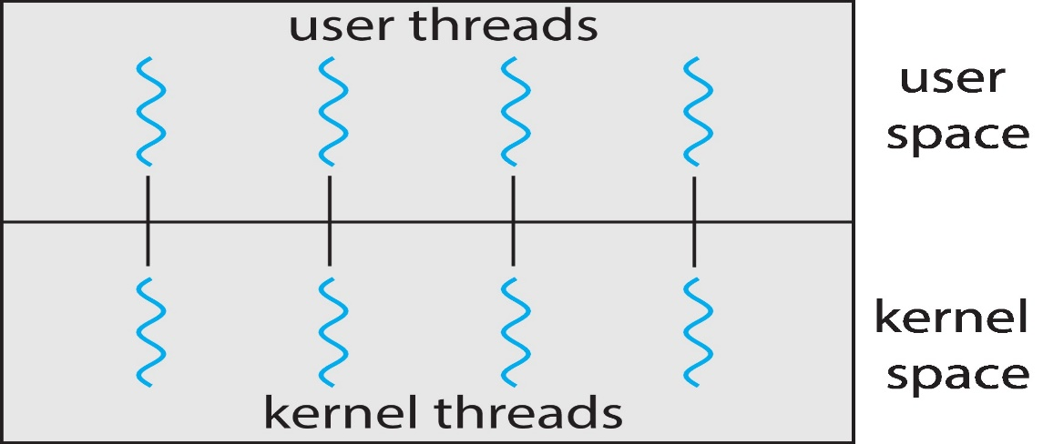
Thread Types
User threads
Support for thread is provided at the user level
Usually by user-level library
Kernel threads
Support for thread is provided at the kernel level
Usually by OS

Slide 36
Multithreading Models
Many-to-One Model
One-to-One Model
Many-to-Many Model

Slide 37
Many-to-One
Used on systems that do not support kernel threads.
Thread management is done by thread library in user space: Efficient
Why? (shown later)
Many-to-One: many user-level threads mapped to single kernel thread, i.e., kernel process
傳統沒有使用thread的processes我們視為single thread process
Blocking problem: entire process is blocked if a thread makes a blocking system call
No support for running in parallel on MP
Since the kernel only sees a single thread

Slide 38
Many-to-One
Examples:
Solaris Green Threads, GNU Portable Threads
However, very few systems continues to use this model
Cannot take advantages of multiple cores

Slide 39
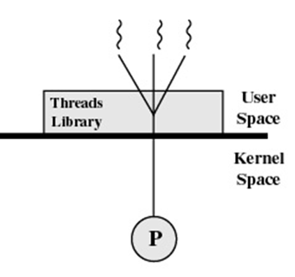
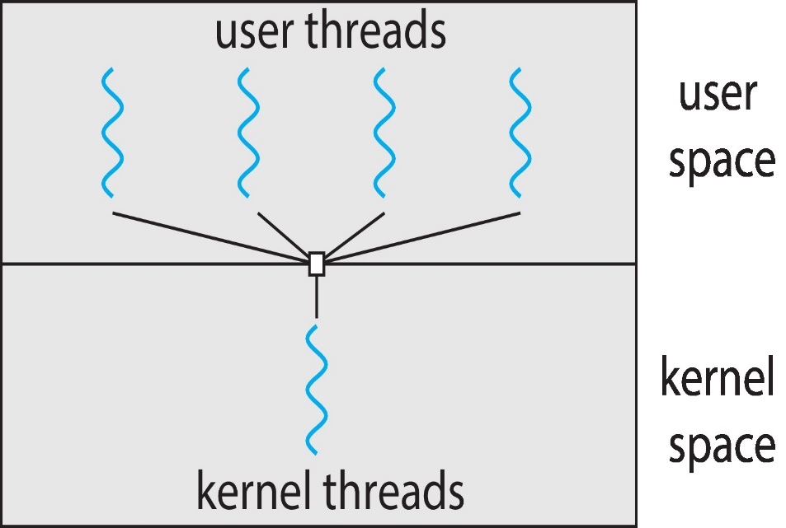
Many-to-One Model
kernel thread

Slide 40
Many-to-One Model (If Only One Processor)
Code Section
Thread 1
main()
{
a = a +1;
pthread_create(runner());
}
runner()
{
b = b + 5;
pthread_create(readrun());
}
readrun()
{
c = c + 2;
read();
}
a process
Thread 1
Thread 1
Context switch
Thread 2
Thread 2
Thread 2
Context switch
Thread 3
Thread 3
Thread 3
Thread Library
Stack
Stack
Stack
user level
thread descriptor
thread descriptor
thread descriptor
kernel level
PCB
(process control block)
blocked
kernel thread (or kernel process)

Slide 41
Another Example: 房間出租

Slide 42
One-to-One
Used on systems that support kernel threads.
Each user-level thread maps to a kernel thread
Good: more concurrency
No blocking system call problem
If a thread makes a blocking system call, kernel can run another thread
Allow multiple threads to run in parallel on multiprocessors
Bad:
Creating a user thread requires creating a kernel thread
Besides, high overhead if there are many kernel threads
Thus, OS may restrict the number of user threads to be created
Most OS use this model
Windows NT/XP/2000, Linux, Solaris 9 and later

Slide 43
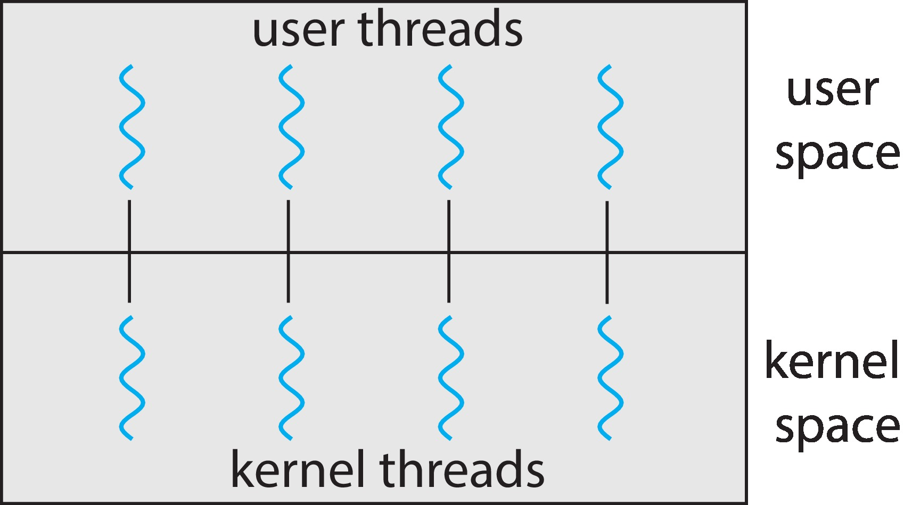
One-to-one Model

Slide 44
One-to-One Model (If Only One CPU is Available)
Thread 1
main()
{
a = a +1;
pthread_create(runner());
}
runner()
{
b = b + 5;
pthread_create(readrun());
}
readrun()
{
c = c + 2;
read();
}
Thread 1
Code Section
Thread 1
context switch
Thread 2
Thread 2
Thread 2
context switch
Thread 3
Thread 3
a process
Thread 3
context switch
clone()
clone()
Thread Library
thread descriptor
thread descriptor
thread descriptor
kernel level
Stack
Stack
Stack
PCB
(process control block)
Kernel
thread
descriptor
Kernel
Thread
descriptor
Kernel
Thread
descriptor
run
run
run
ready
ready
waiting

Slide 45
Many-to-One Model (If Three CPU Cores are Available)
main() {
pthread_create(runner());
x = x +1;
y = y + 1;
}
runner() {
pthread_create(readrun());
i = i + 6;
j = j * 8;
}
readrun()
{
c = c + 2;
d = 10 ;
}
a process
Thread 1
Thread 1
If three CPU cores are available, these three threads can run in parallel
Thread 2
Thread 2
Thread 3
Thread 3
Thread Library
thread descriptor
thread descriptor
thread descriptor
user level
kernel level
Stack
Stack
Stack
PCB
(process control block)
Kernel
thread
descriptor
Kernel
Thread
descriptor
Kernel
Thread
descriptor

Slide 46
補充：System Call Overhead
System call overhead
Mode switch cost
State save
System call table lookup
...
FlexSC: Flexible System Call Scheduling with Exception-Less System Calls
Summary:
System calls incur quite a large overhead compared to function calls.

Slide 47
Many-to-Many Model
Problems of previous two models
Many-to-one: true concurrency is not gained
One-to-one: cannot create too many user threads
Many-to-many
Allows M user level threads to be mapped to N kernel threads, where N <= M
Many-to-many
True concurrency is guaranteed
Kernel thread can run in parallel on a multiprocessor
No blocking system call problem
Unlimited number of user threads
User can create as many user threads as possible

Slide 48
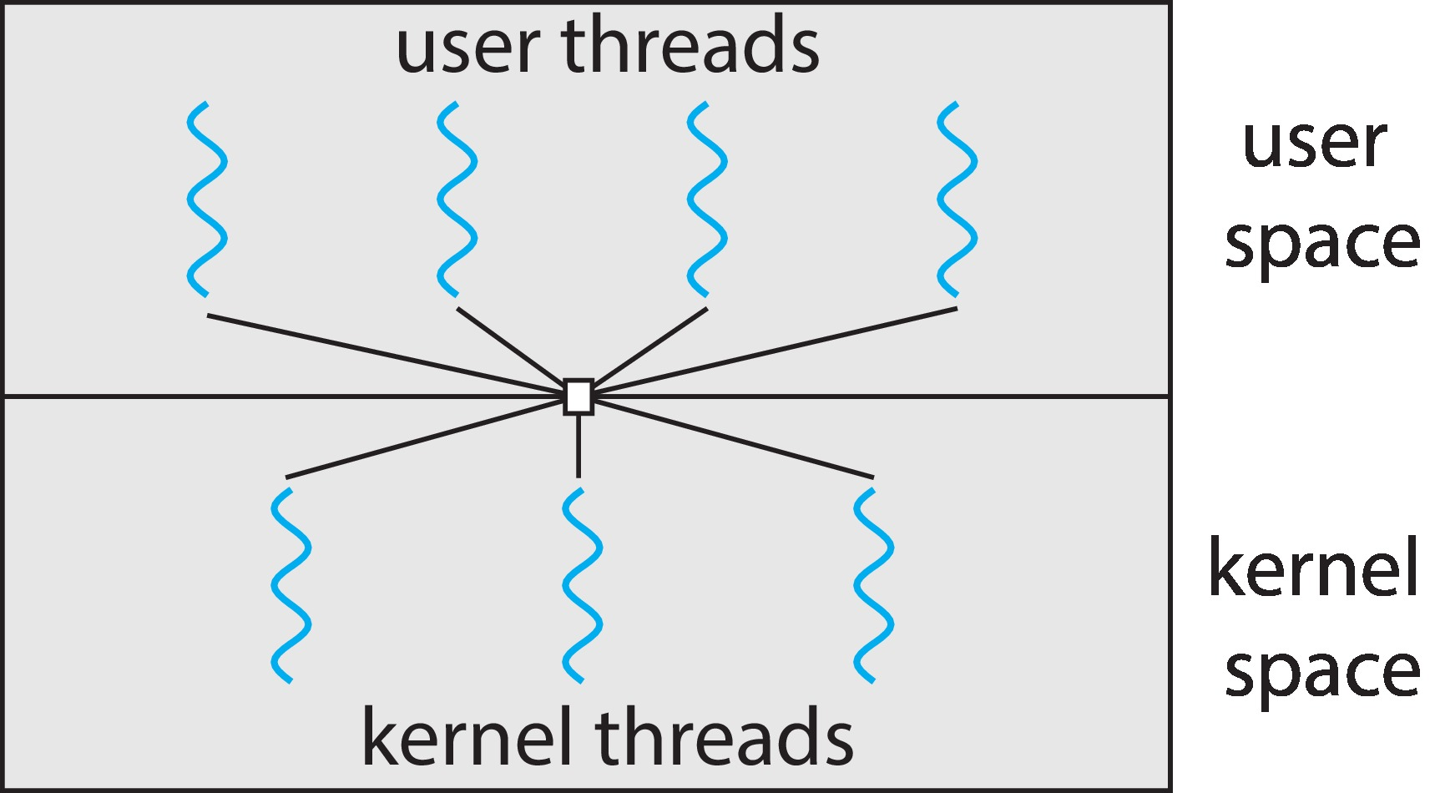
Many-to-Many Model
The number of kernel threads is limited to 3, no matter how many user threads. In one-to-one model, only allow three user threads

Slide 49
你可以自己畫類似Pages 45或46的動畫嗎？

Slide 50
Many-to-Many Model (Cont.)
Two-level Model: one variation on many-to-many
Two-level model = many-to-many + one-to-one models
Although many-to-many is the most flexible
Difficult to implement (addressed in Section 4.6.5)
Limit the number of kernel threads is becoming less important
Since there is an increasing number of processing core
Thus, most OS use one-to-one model

Slide 51
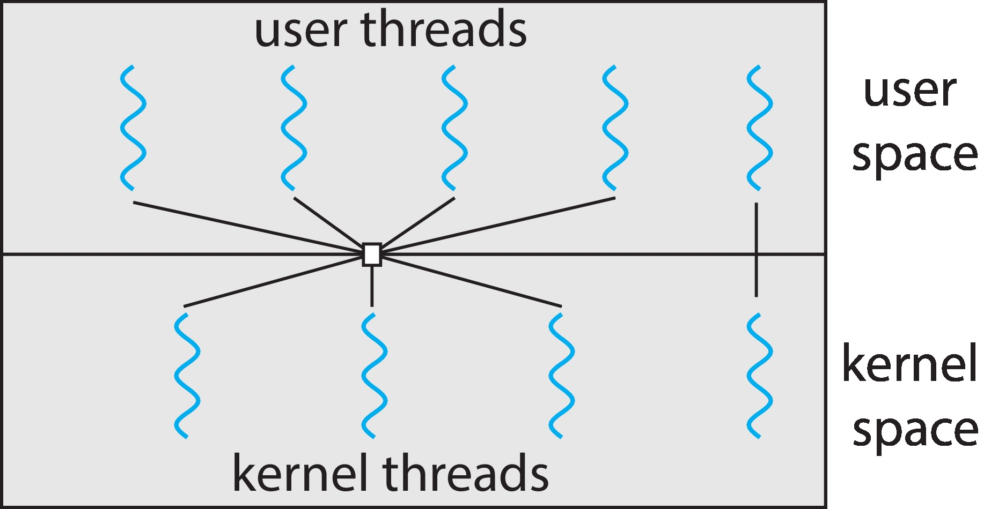
Two-level Model

Slide 52
Summary: User Thread vs. Kernel Thread
User thread (many-to-one model)
Thread management done by user-level threads library
The kernel is not aware of the existence of threads
Fast to create and manage
Block all threads for a blocking system call
Cannot take advantage of multi-processors
Examples
POSIX Pthreads
Win32 threads
Java threads

Slide 53
Summary: User Thread vs. Kernel Thread (Cont.)
Kernel thread (one-to-one model)
Supported by the kernel
Slower to create and manage
No blocking system call problem
Can take advantage of a multi-processor environment
Examples
Windows
Solaris
Linux

Slide 54
Outline
Overview
Multicore Programming
Multithreading Models
Thread Library
Implicit Threading
Threading Issues
Operating-System Examples

Slide 55
Thread Library
Provide an APIs for creating and managing threads
Two approaches
User-level thread
Thread library is in the user space without kernel support
Invoke a function in the library is a local function call in user space
Kernel-level thread
Supported by OS
Invoke a function in the library is a system call to the kernel

Slide 56
Thread Library (Cont.)
Three main thread libraries
POSIX Pthreads (Pthreads)
Can be provided as a user- or kernel-level library
Win32 threads
Kernel-level library
Java threads
Use thread library available on the host system, typically
Use Win32 threads in Windows
Use POSIX Pthreads in UNIX or Linux

Slide 57
Strategies for Creating Threads
Strategies for Creating Threads
Asynchronous threading v.s. synchronous threading
Asynchronous threading
After creating child thread, parent thread resumes its execution
Parent thread and children threads run concurrently
Example: a multithreaded Server
Multithreaded Server using asynchronous threading

Slide 58
Strategies for Creating Threads (Cont.)
Synchronous Threading
After creating child thread, parent thread waits for all children threads to terminate
Called fork-join strategy
pthread_join(): wait for a thread
For example, in an array summation example (see the following slide)
Parent thread must wait until all children threads calculate the partial sums
Then, parent thread calculate the final sum of the array

Slide 59
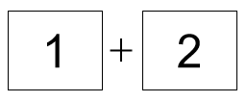
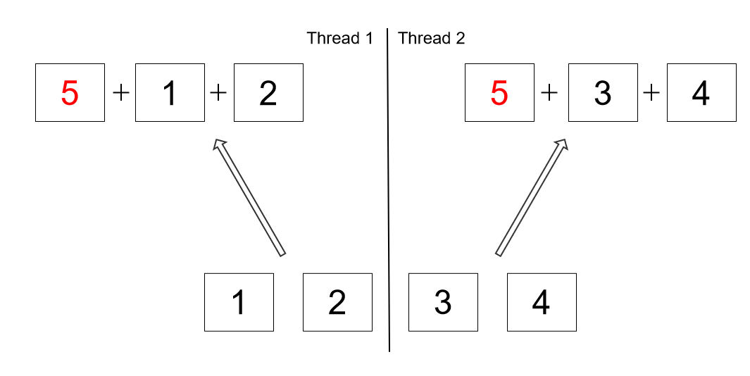
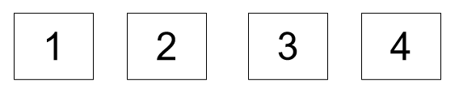
Synchronous Threading: Array Summation Example
thread 0
3
7
thread 1
thread 2
Thread 0 creates threads 1 and 2 and waits for their execution

Slide 60
Outline
Overview
Multicore Programming
Multithreading Models
Thread Library
Pthreads
Windows Threads
Java Threads
Implicit Threading
Threading Issues
Operating-System Examples

Slide 61
Pthreads
A POSIX standard (IEEE 1003.1c) API
A specification for thread behavior, not implementation
API specifies behavior of the thread library
Implementation is up to development of the library
Common in UNIX operating systems
Solaris, Linux, Mac OS X

Slide 62
The Pthreads API (Incomplete)
Implementation, e.g., pthread_create(), is up to development of the library
Table 1. POSIX thread management functions (incomplete).

Slide 63
Example
A Pthreads example
A thread begins with main()
main() creates a second thread by calling pthread_create()
Both threads share the global variable sum
Wait for a thread to terminate by calling pthread_join()

Slide 64
Example 1
#include <pthread.h>
#include <stdio.h>
int sum;
Void *runner(void *param)
int main (int argc, char *argv[])
{
pthread_t tid; /* the thread identifier */
pthread_attr_t attr; /* set of thread attributes */
// set default thread attributes, e.g. stack size, scheduling info.
pthread_attr_init(&attr);
// create the thread, using the default attributes
pthread_create(&tid, &attr, runner, argv[1]);
// wait for the thread to exit
pthread_join(tid, NULL)
printf(“sum = %d\n”, sum);
}
void *runner (void *param)
{
printf("Hello World! It's me, thread #%d!\n", tid);
pthread_exit(NULL);
}

Slide 65
Example 2: If Three CPU Cores are Available
main() {
pthread_create(runner());
x = x +1;
y = y + 1;
}
runner() {
pthread_create(readrun());
i = i + 6;
j = j * 8;
}
readrun()
{
c = c + 2;
d = 10 ;
}
a process
Thread 1
Thread 1
If three CPU cores are available, these three threads can run in parallel
Thread 2
Thread 2
Thread 3
Thread 3

Slide 66
Example 3
Above example creates only one thread
If several threads are created
Calling pthread_join()10 (=NUM_THREADS) times

Slide 67
Outline
Overview
Multicore Programming
Multithreading Models
Thread Library
Pthreads
Windows Threads (Skip!)
Java Threads
Implicit Threading
Threading Issues
Operating-System Examples

Slide 68
Outline
Overview
Multicore Programming
Multithreading Models
Thread Library
Pthreads
Windows Threads
Java Threads (Skip!)
Implicit Threading
Threading Issues
Operating-System Examples

Slide 69
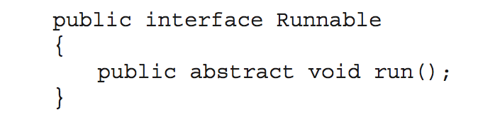
Java Threads
Java threads are managed by the JVM
Typically implemented using the threads model provided by underlying OS
Java threads may be created by:
Extending Thread class
Implementing the Runnable interface
Standard practice is to implement Runnable interface

Slide 70
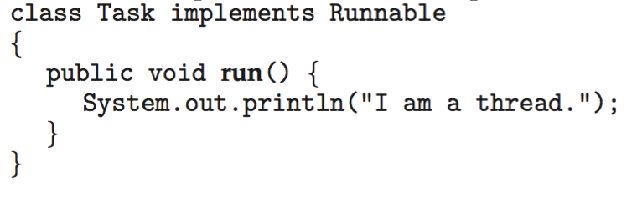
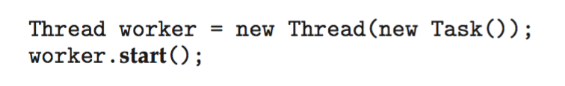
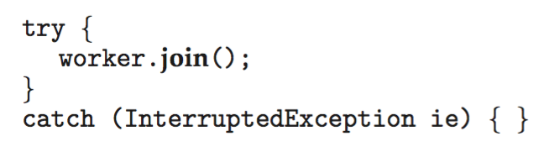
Java Threads (Cont.)
Implementing Runnable interface:
Creating a thread:
Waiting on a thread:

Slide 71
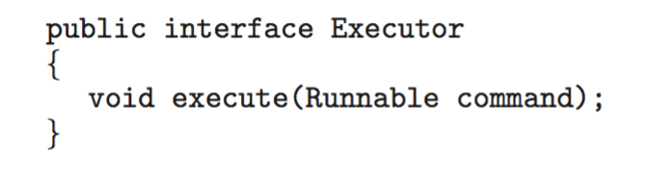
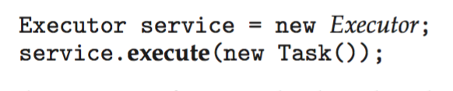
Java Executor Framework
Rather than explicitly creating threads, Java also allows thread creation around the Executor interface:
The Executor is used as follows:

Slide 72
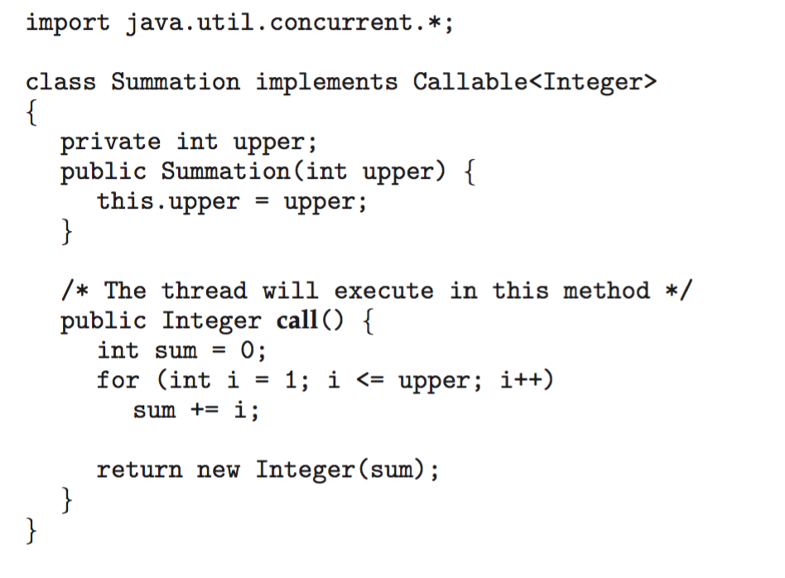
Java Executor Framework

Slide 73
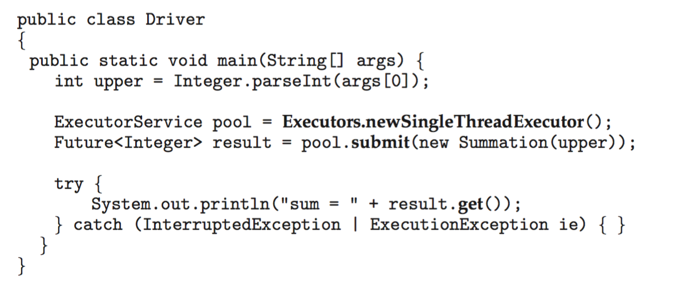
Java Executor Framework (Cont.)

Slide 74
Outline
Overview
Multicore Programming
Multithreading Models
Thread Library
Implicit Threading
Threading Issues
Operating-System Examples

Slide 75
Implicit Threading
Due to multicore computers, applications may contains hundreds, or even thousands, of threads
But, design such an multi-threading application is not easy
Address the challenges in page 32
Synchronous and deadlock issue (chapter 6 and 7)
Solutions: implicit threading
Creation and management of threads are done by compilers and libraries (shown later), rather than programmers

Slide 76
Implicit Threading
OpenMP
Grand Central Dispatch
Intel Thread Building Blocks
Fork Join
Summary

Slide 77
OpenMP
Consists of compiler directives and APIs for C, C++, or FORTRAN
What is compiler directives? (shown in the following slide)
Provides support for parallel programming
Define parallel regions
Blocks of code that can run in parallel
Shown in the following slide
Programmers only insert compiler directives to identify parallel regions
These directives causes the OpenMP library to execute the region in parallel

Slide 78
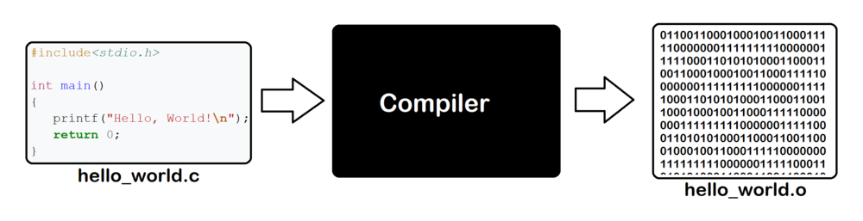
補充：Compiler and Compiler Directive
Compiler directive
Source file
Object file

Slide 79
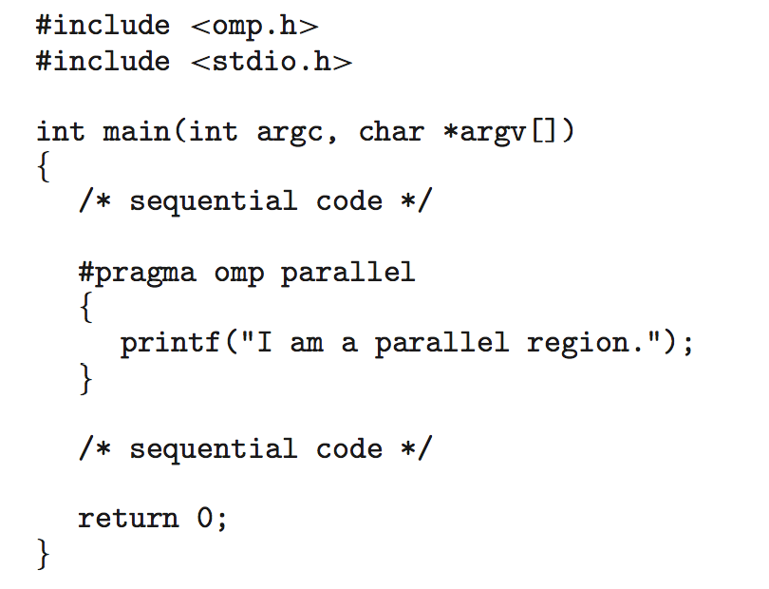
Example 1
Ex1: #pragma omp parallel
Create as many threads as there are CPU cores
Compiler directive
parallel
region

Slide 80
Creation and Management of Threads are Done by Compilers and Libraries
#pragma omp parallel
{
printf(“Parallel region.”);
}
a = a + 1;
b = b – 1;
……
Execution
file
compiler
pthread_create();
pthread_create();
…
pthread_join();
pthread_join();
must recognize the directive (parallel region)
Library
Creation and Management of Threads are done by library
The number of threads are determined by library
pthread_create() {
clone() …
}
pthread_join(); {
}
Pthread Library
clone()……
OS

Slide 81
Example 2
Ex2: #pragma omp parallel for
for(i=0;i<N;i++) {
c[i] = a[i] + b[i];
}
Run the for loop in parallel
OpenMP divides the work in the for loop among the threads that it creates (shown in the following slide)

Slide 82
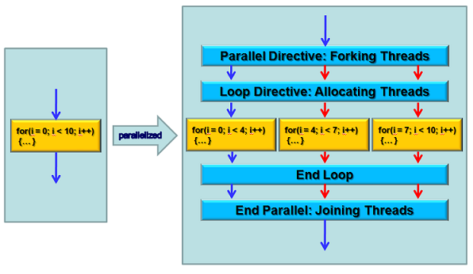
Transfer to Pthreads by OpenMP Library
These three for loops are then executed by multiple threads (determined by library)
http://aaz-blogger.blogspot.com/2011/03/openmp-parallel-construct.html

Slide 83
Implicit Threading
OpenMP
Grand Central Dispatch
Intel Thread Building Blocks
Fork Join
Summary

Slide 84
Grand Central Dispatch
Apple technology for Mac OS X and iOS
Allow identification of section of code (tasks) to run in parallel
By defining “block”
Like OpenMP
A “blocks”
Syntax: ^{…}
Examples: ˆ{printf("I am a block"); }
Then, the printf() can be run parallel

Slide 85
Grand Central Dispatch (Cont.)
Grand Central Dispatch (GCD)
Places tasks on a dispatch queue
Tasks are removed from the queue in FIFO order
Once a task is removed, it is assigned to a thread
Shown in the following slide
The number of threads is determined by GCD

Slide 86

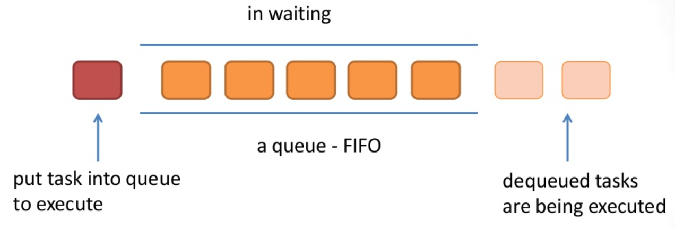
Grand Central Dispatch (Cont.)
threads
threads
threads
threads
https://www.slideshare.net/cqtt191/grand-dispatch-central

Slide 87
Implicit Threading
OpenMP
Grand Central Dispatch
Intel Thread Building Blocks
Fork Join
Summary

Slide 88
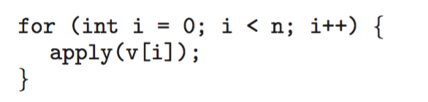
Intel Threading Building Blocks (TBB)
A library for designing parallel C++ programs
Examples: pass each value in an array v to the apply()function
E.g., the apply()function add one to each input parameter
Method 1: a serial version of a simple for loop
Bad: time consuming, fail to utilize multi-core processing

Slide 89
Intel Threading Building Blocks (TBB) (Cont.)
Method 2: uses TBB
TBB provides a parallel_for template
TBB divides the loop iteration into a number of tasks (工作)
Then, TBB creates a number of threads and assign tasks to threads
See the following slide
typedef unsigned int size_t
start
end
index
Loop body

Slide 90
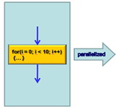
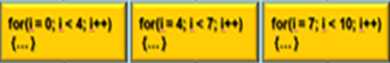
Intel Threading Building Blocks
divided into three tasks
assign to two threads
threads
threads

Slide 91
Implicit Threading
OpenMP
Grand Central Dispatch
Intel Thread Building Blocks
Fork Join
Summary

Slide 92
Fork Join
fork-join model described in Section 4.4 is explicit
E.g., Pthreads, Windows Threads,…
Multiple threads are forked, and then joined
A Synchronous model
Characterized as explicit thread creation
See the following slide
In fact, fork-join model can also be implicit

Slide 93
複習：Example 1
#include <pthread.h>
#include <stdio.h>
int sum;
Void *runner(void *param)
int main (int argc, char *argv[])
{
pthread_t tid; /* the thread identifier */
pthread_attr_t attr; /* set of thread attributes */
// set default thread attributes, e.g. stack size, scheduling info.
pthread_attr_init(&attr);
// create the thread, using the default attributes
pthread_create(&tid, &attr, runner, argv[1]);
// wait for the thread to exit
pthread_join(tid, NULL)
printf(“sum = %d\n”, sum);
}
void *runner (void *param)
{
printf("Hello World! It's me, thread #%d!\n", tid);
pthread_exit(NULL);
}

Slide 94
Fork Join (Cont.)
Implicit fork-join model
Fork constructs tasks, instead of threads
呼叫fork不會產生對應的thread, 而是產生對應的tasks
Tasks: 工作, 例如執行加法, 此處不是指process/threads
A library
Determines the actual number of threads to create
E.g. four threads are created since there are four CPU cores
Create the threads, manages the threads, and assign tasks to threads
Useful for recursive divide-and-conquer algorithms

Slide 95
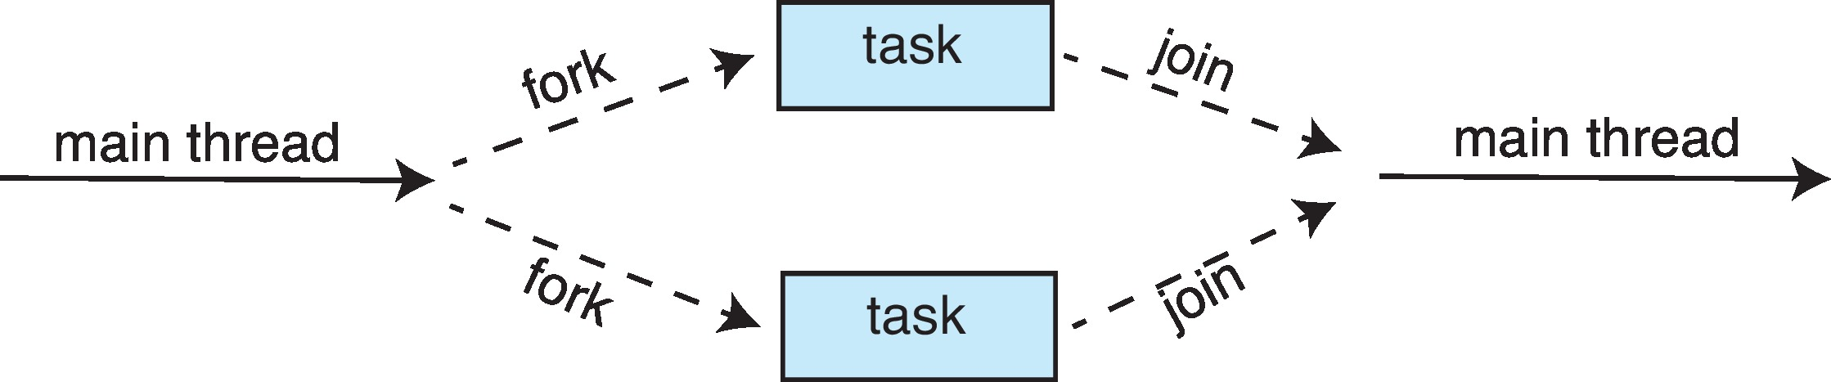
Implicit Fork-Join Model
Tasks are constructed, instead of threads, during the fork stage

Slide 96
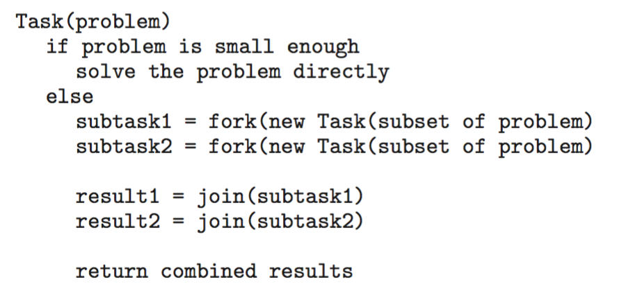
Fork-Join Parallelism
General algorithm for fork-join strategy:

Slide 97
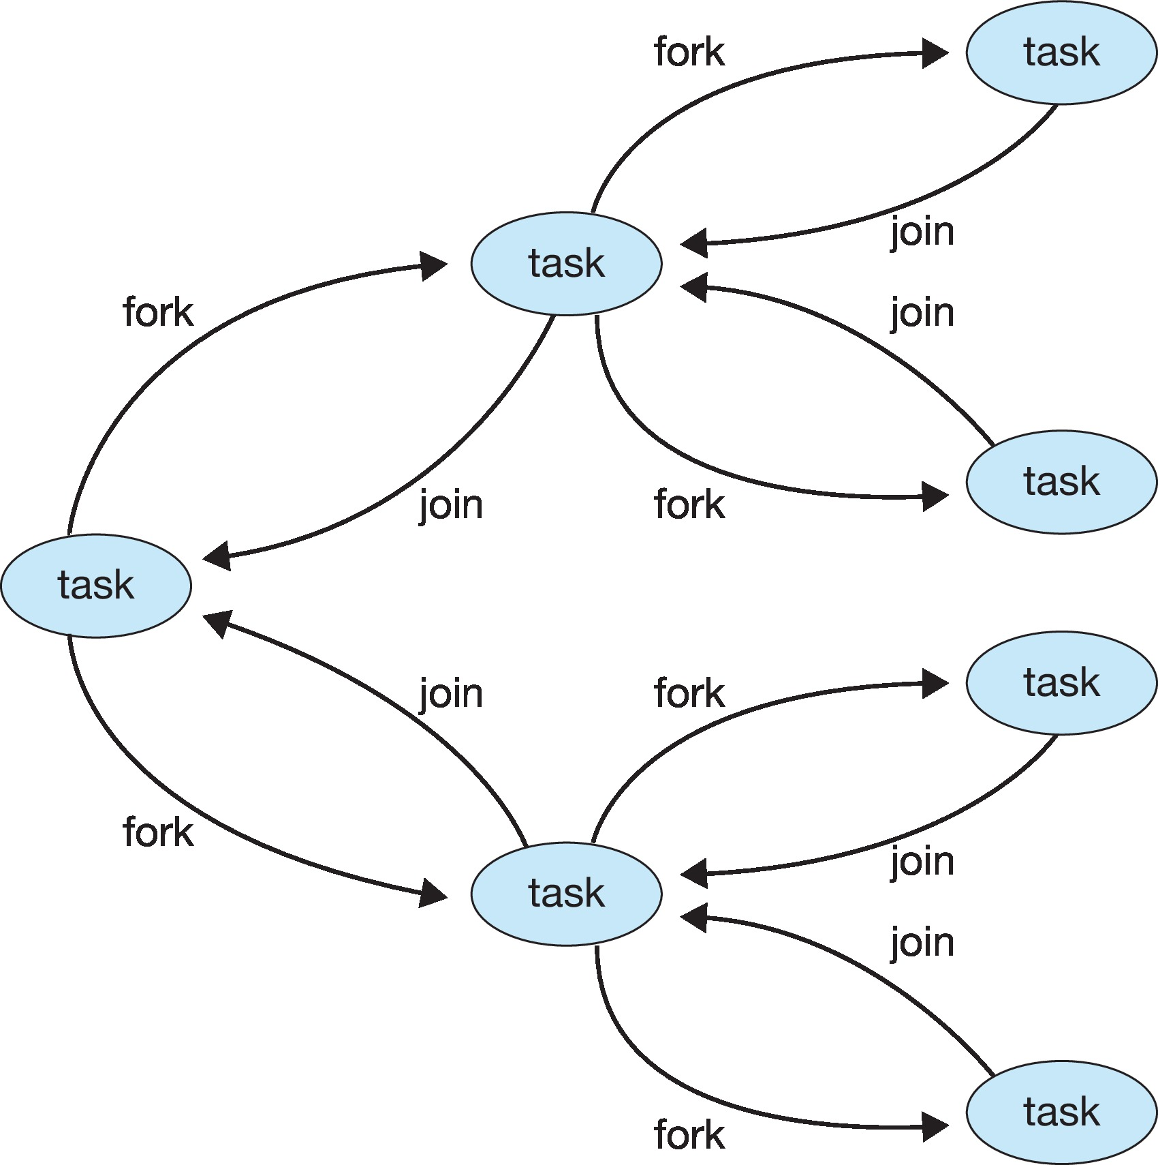
Fork-Join Parallelism (Cont.)
Tasks are constructed, instead of threads, during the fork stage

Slide 98
Creation and Management of Threads are Done by Compilers and Libraries
fork()…
join()…
a = a + 1;
b = b – 1;
……
Execution
file
compiler
pthread_create();
pthread_create();
…
pthread_join();
pthread_join();
Library
Creation and Management of Threads are done by library
The number of threads are determined by library
pthread_create() {
clone() …
}
pthread_join(); {
}
Pthread Library
clone()……
OS

Slide 99
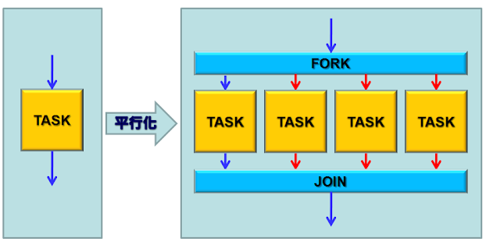
Fork-Join Parallelism (Cont.)
four small tasks
one big task
These four tasks are then executed by multiple threads (determined by library)
http://aaz-blogger.blogspot.com/2011/03/openmp-parallel-construct.html

Slide 100
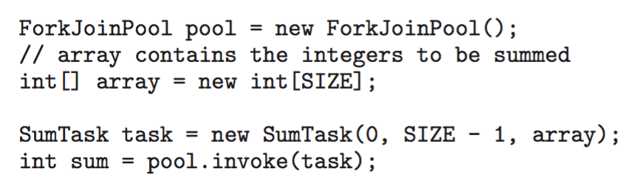
Example: Fork-Join Parallelism in Java (Skip!)
Java introduces a new thread pool: ForkJoinPool
SumTask is shown in the following slides

Slide 101
Example: Fork-Join Parallelism in Java (Cont.) (Skip!)
Java fork-join strategy is organized around the abstract base ForkJoinTask
RecursiveTask and RecursiveAction classes extend ForkJoinTask
RecursiveTask return a result, via return value specified in compute()
RecursiveAction does not return result
SumTask extends RecursiveTask
See the next slide

Slide 102
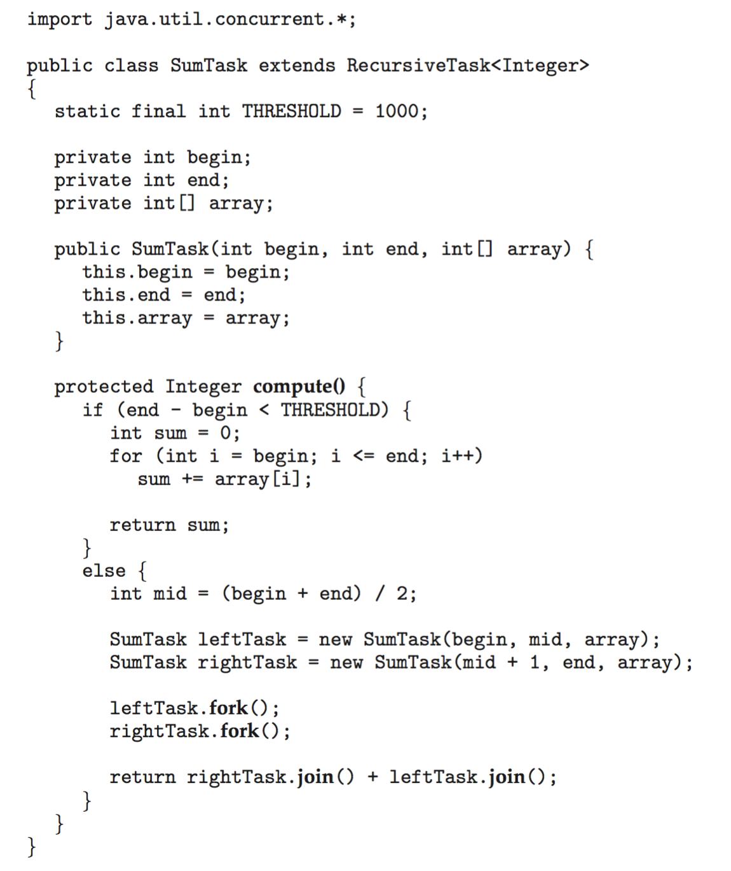
Example: Fork-Join Parallelism in Java (Cont.) (Skip!)

Slide 103
Fork-Join Parallelism in Java (Skip!)
Idea
The fork primitive allows the programmer to specify potential parallelism
The implementation then maps onto actual threads
Java library constructs a pool of threads
Automatically balances the load of tasks among these threads
E.g., there are thousands of tasks and only four threads
By Work Stealing Algorithm
Each thread maintains a queue of tasks
Once a thread’s queue is empty, steal a task from another thread’s queue

Slide 104
Implicit Threading
OpenMP
Grand Central Dispatch
Intel Thread Building Blocks
Fork Join
Summary

Slide 105
Summary
Implicit Threading
Application developers only needs to identify tasks—not threads—that can run in parallel.
A task is usually written as a function
Then run-time library/compiler maps tasks to threads, and determine the thread creation and management
Advantages
Developers only needs to identify what operations can run in parallel
The library manages the details

Slide 106
Outline
Overview
Multicore Programming
Multithreading Models
Thread Library
Implicit Threading
Threading Issues
Operating-System Examples

Slide 107
Threading Issues
Thread Pools
Semantics of fork() and exec() system calls
Signal handling
Thread cancellation
Thread-Local Storage
Scheduler activations

Slide 108
Thread Pools
Consider a web server that service each request with a thread
Creating and destroy threads dynamically – time consuming
Unlimited number of threads – exhaust system resources
Sol.: Thread Pools
Create a number of threads in a pool in advance
Receiving a request → awaken a thread from the pool → pass it the request to service
Once the thread completes its service → return to the pool
If no available thread → server waits until one becomes free

Slide 109
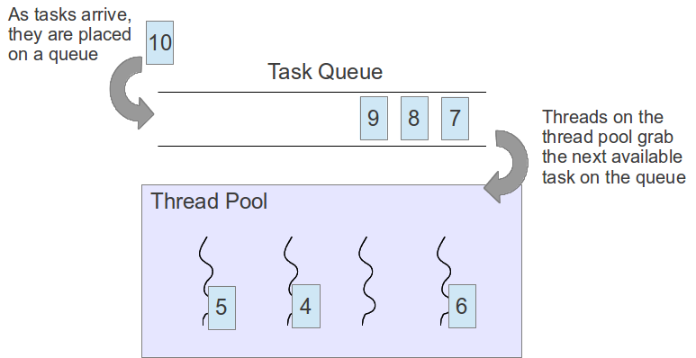
Thread Pools
https://www.classes.cs.uchicago.edu/archive/2019/spring/12300-1/pa3.html

Slide 110
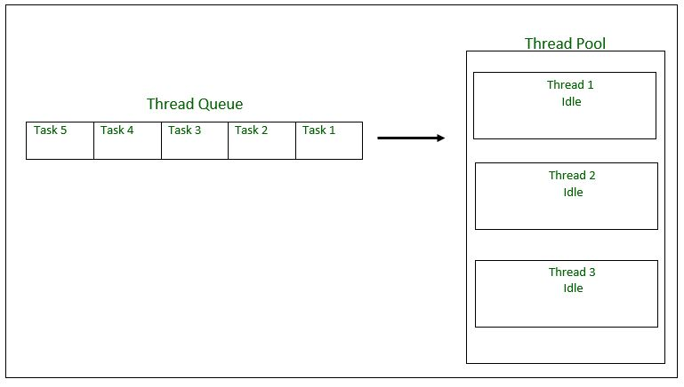
Thread Pools: Before
https://iter01.com/29330.html

Slide 111
Thread Pools: After
Running task 1
Task 5
Task 4
Running task 2
Running task 3
https://iter01.com/29330.html

Slide 112
Thread Pools (Cont.)
Advantages:
Faster to service a request
By an existing thread rather than creating a new thread
Allows the number of threads in the application(s) to be bound to the size of the pool

Slide 113
Threading Issues
Thread Pools
Semantics of fork() and exec() system calls
Signal handling
Thread cancellation
Thread-Local Storage
Scheduler activations

Slide 114
Semantics of fork() and exec()
fork() in a multi-thread application?
If one thread calls fork()
Duplicate all threads or
Duplicate only the thread that invoked fork()
Some UNIX system supports two versions of fork()
How about exec()?
If a thread invokes the exec() system call
Replace the entire process – including all threads
Why? threads share the .code section

Slide 115
One Process with Multiple Threads
one process with four threads
memory
code
data
stack
stack
stack
stack

Slide 116
Threading Issues
Semantics of fork() and exec() system calls
Signal handling
Thread cancellation
Thread-Local Storage
Scheduler activations

Slide 117
Signal Handling
Signals are used in UNIX systems to notify a process that a particular event has occurred
Events
Illegal memory access
Divided by zero…
Ctrl-C to terminate a process
Timer expires
…

Slide 118
Signal Handling (Cont.)
All signals follow the same pattern
1. Signal is generated by a particular event
2. Signal is delivered to a process
3. Signal is handled by the process’s signal hander
Each signal is handled by one of two handlers
A default signal handler in the kernel
A user-defined signal handler in the user program

Slide 119
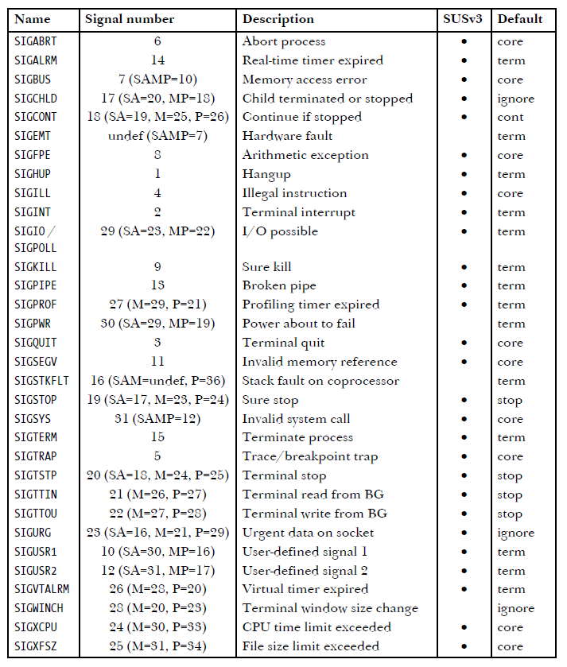
Table 20-1: Signal Types and Default Actions

Slide 120
Signal Handling (Cont.)
In single-threaded programs
Signals are delivered to a process
In a multi-threaded programs
Deliver the signal to the thread to which the signal applies
Example: Illegal memory access, divided by zero
Deliver the signal to every thread in the process
Example: a Ctrl-C asynchronous signal
Deliver the signal to certain threads in the process
pthread_kill( pthread_t tid, int signal)
Assign a specific thread to receive all signals for the process

Slide 121
Threading Issues
Semantics of fork() and exec() system calls
Signal handling
Thread cancellation
Thread-Local Storage
Scheduler activations

Slide 122
Thread Cancellation
Thread Cancellation
Terminate a thread before it has completed
Example:
Searching a database using multiple threads
If one thread finds the result, cancel the other threads
猜密碼
If one thread 猜到密碼，cancel other threads

Slide 123
Thread Cancellation (Cont.)
Target thread: the thread to be canceled
Two approaches for thread cancellation:
Asynchronous cancellation
Terminates the target thread immediately
May have problems in resource reclaim
The target thread is holding resources
The target thread is in the midst of updating a shared data
Deferred cancellation
The target thread periodically check if it should terminate
Allow the target thread to terminate itself in a safe point, called cancellation point

Slide 124
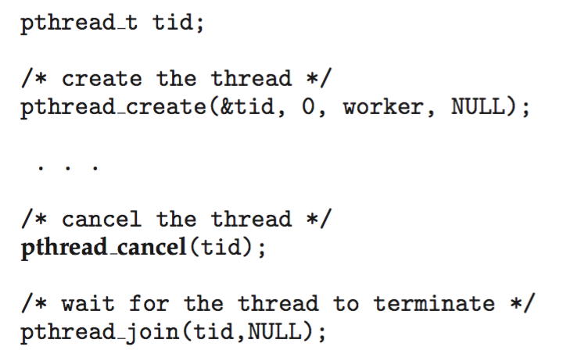
Example: Pthread (Skip!)
Cancel a target thread: call pthread_cancel()
Example:

Slide 125
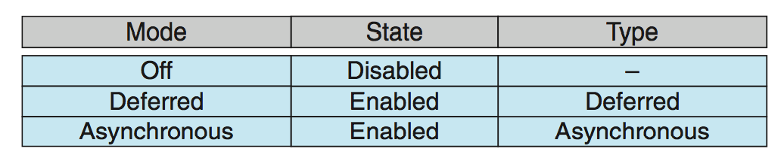
Example: Pthread (Cont.) (Skip!)
Invoking pthread_cancel() indicates only a request to cancel the target thread
But actual cancellation depends on the setting of the target thread
Linux supports three cancellation modes
Off, deferred, and asynchronous modes
By defining the state and type

Slide 126
Example: Pthread (Cont.) (Skip!)
If cancellation is disabled, cannot be canceled
Cancellation remains pending until thread enables it
Default type is deferred
Upon receiving a cancellation request, cancellation only occurs when thread reaches cancellation points
e.g, calling pthread_testcancel()
Pthreads further allow a function to be set as a cleanup handler
The hander is invoked if a thread is canceled
Asynchronous cancellation is not recommended

Slide 127
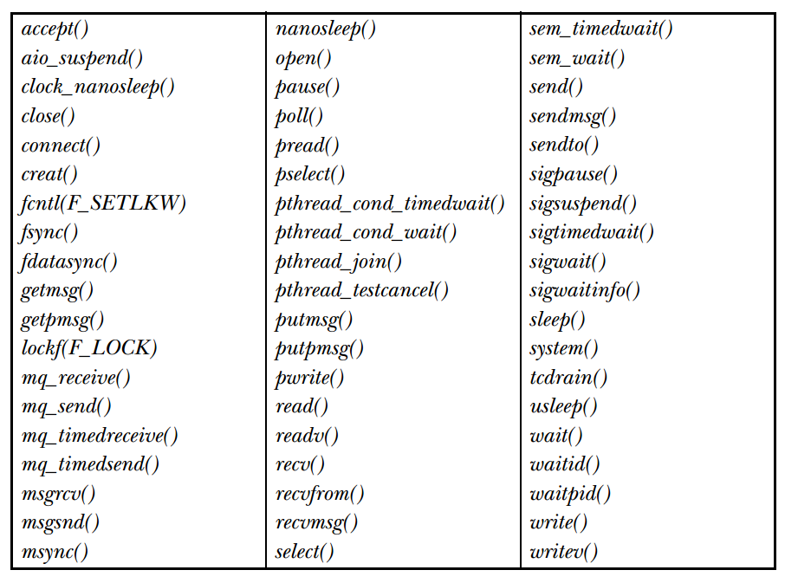
Functions that Can Be Cancellation Points by SUSv3

Slide 128
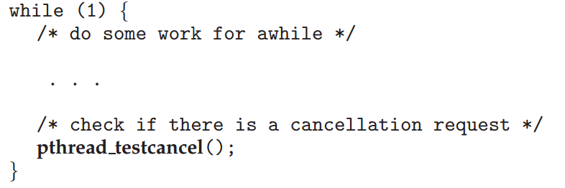
Pthread_testcancel() Example

Slide 129
Threading Issues
Semantics of fork() and exec() system calls
Signal handling
Thread cancellation
Thread-Local Storage
Scheduler activations

Slide 130
Thread-Local Storage
Although threads belonging to the same process share the data
Sometimes, each thread might need its own copy of certain data
Solution: Thread-local Storage (TLS)
Allows each thread to have its own copy of data
Different from local variables
Local variables visible only during the closing function
TLS visible across function invocations
Similar to static data
However, TLS is unique (not shared) to each thread

Slide 131
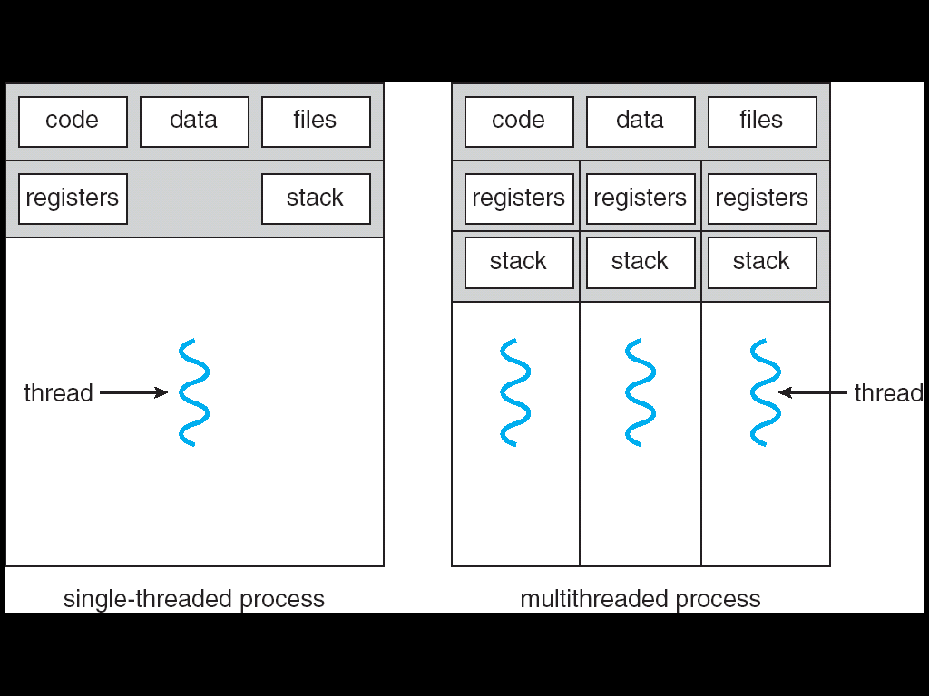
Single and Multithreaded Processes
thread-local
storage

Slide 132
複習：Static v.s. Global
Static variable: lifetime of the variable
Its lifetime is the entire run of the program
Global variable: scope of the variable

Slide 133
Threading Issues
Semantics of fork() and exec() system calls
Signal handling
Thread cancellation
Thread-Local Storage
Scheduler activations (Skip!)

Slide 134
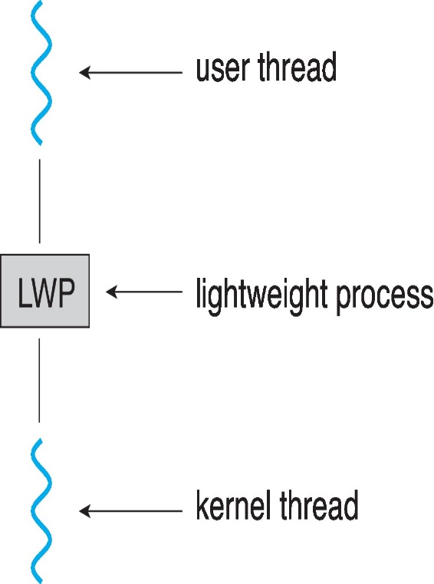
Scheduler Activations
Typically M:M and two-level models use an intermediate data structure between user threads and kernel threads – lightweight process (LWP)
Encapsulation of a kernel thread
Appears to be a virtual processor on
which applications can schedule a
user thread to run
Each LWP attached to kernel thread

Slide 135
Scheduler Activations (Cont.)
But, how many LWPs to be created?
Typically, an LWP is required for each concurrent blocking system call
Five LWPs if five file-read request occur simultaneously
If only four LWPs, one request must wait!
However, how to achieve the goal?
Solution: Scheduler Activations

Slide 136
Scheduler Activations
Scheduler Activations
A scheme for communication between the kernel and the user thread library
This communication allows an application to maintain the correct number kernel threads for best performance
The kernel informs an application about certain events, e.g.,
A user thread, say x, making a blocking system call
Kernel allocating a new kernel thread to the process
How to inform: upcalls
A communication mechanism from the kernel to the user applications
Seems violating the layered architecture
A upcall is handled by the thread library with an upcall handler, which must run on a LWP

Slide 137
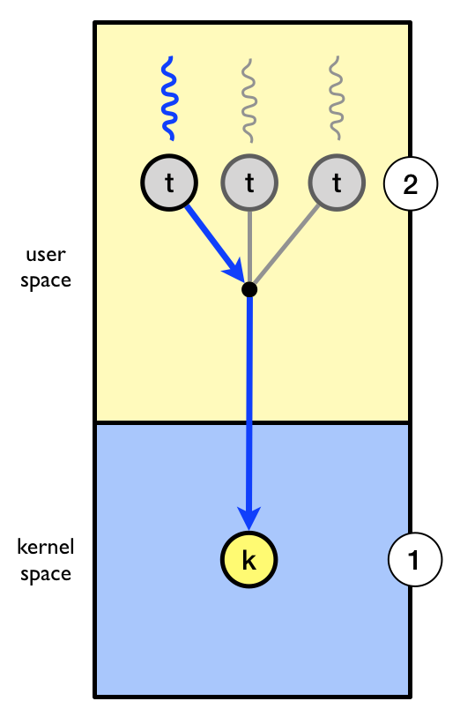
Example
The kernel has allocated one kernel thread to a process with three user-level threads
The three user level threads take turn executing on the single kernel-level thread.
https://www.it.uu.se/education/course/homepage/dsp/vt19/modules/module-4/implementing-threads/

Slide 138
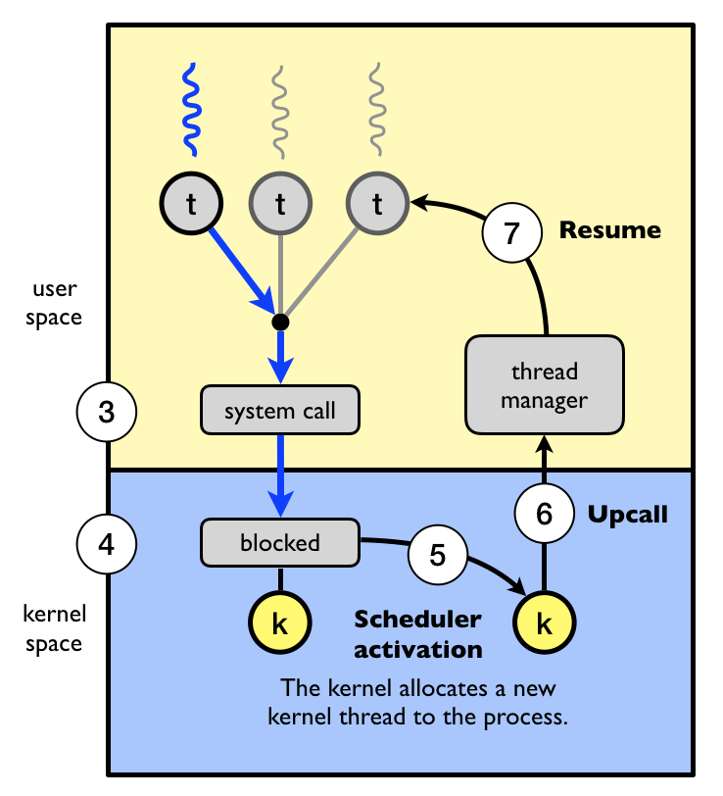
Example (Cont.)
The user thread x makes a blocking system call
Kernel blocks the user thread and the corresponding kernel thread
Scheduler activation: kernel decides to allocate a new kernel thread
Otherwise, the process is blocked
Two kernel threads are now allocated
Upcall: the kernel notifies the user-level thread manager
user-level thread x is now blocked
A new kernel thread is available
The user-level thread manager move other thread to the new kernel thread
https://www.it.uu.se/education/course/homepage/dsp/vt19/modules/module-4/implementing-threads/

Slide 139
Scheduler Activations
Questions:
Why 1:1 and M:1 models does not need the scheduler activation?

Slide 140
Outline
Overview
Multicore Programming
Multithreading Models
Thread Library
Implicit Threading
Threading Issues
Operating-System Examples

Slide 141
Linux Threads
Linux refers to them as tasks rather than threads
Thread creation is done through clone() system call
clone() allows how much sharing between parent and child tasks
CLONE_FS: share the same file-system information
CLONE_VM: share the same memory space
CLONE_SIGHAND: share the same signal handler
CLONE_FILES: share the same set of open files
If all above flags are set
clone() is similar to create a thread
If none of flags are given
clone() is similar to the fork()

Slide 142
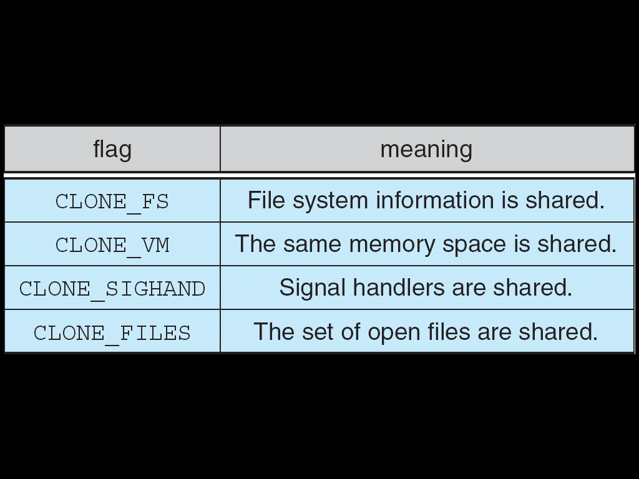
A Sets of Flags to clone()

